Slide 1


Slide 2
The Art of Grinding Coffee

Slide 4
What is the Most Important Coffee Appliance You Could Ever Own?

Slide 5
What is the Most Important Coffee Appliance You Could Ever Own?
Coffee Grinder

Slide 6
Grinding Coffee Correctly Sets the Foundation for Brewing Great Coffee at Home.
Having the Right Kind of Grinder is the Most Important Way to Achieve This.

Slide 7
There are Two Types of Grinders Available on the Market:

Slide 8
There are Two Types of Grinders Available on the Market:
Blade
Burr

Slide 9
Which Type of Grinder Should We Use?
Blade
Burr

Slide 10
Which Type of Grinder Should We Use?
Blade
Burr

Slide 11
Unfortunately, Not All Burr Grinders Are Created Equal
Size, Shape and RPM of the Motor all Affect the Quality of the Grind

Slide 12
RPM. What is it?

Slide 13
RPM. What is it?
Revolutions Per Minute
Number of Time per Minute the Burrs Rotate

Slide 14
Low RPM
Smaller Burrs
Mostly Conical
Less Heat Build Up
More Static
Less Grind Consistency

Slide 15
High RPM
Higher Performance
Usually Flat Burrs
Beefier Motors
Consistency of Grind
Less Heat Contact

Slide 16
There Are Two Types of Burr Grinders

Slide 17
There Are Two Types of Burr Grinders
Conical
Flat

Slide 18
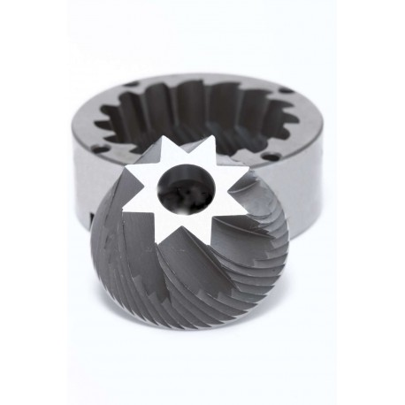
Conical Burrs:

Slide 19
Conical Burrs:
Cone Shaped with a Male and Female Piece

Slide 20
Conical Burrs:
Cone Shaped with a Male and Female Piece
Produce Bimodal Coffee Size Distribution

Slide 21
Bimodal Coffee Distribution:
Under a Microscope Coffee is Made Up of Two Different Particle Sizes

Slide 22
Bimodal Coffee Distribution:
Small Sizes Restrict Flow While Larger Particles Have More Time to Saturate

Slide 23
Bimodal Coffee Distribution:
Produces an Espresso Shot with More Body

Slide 24
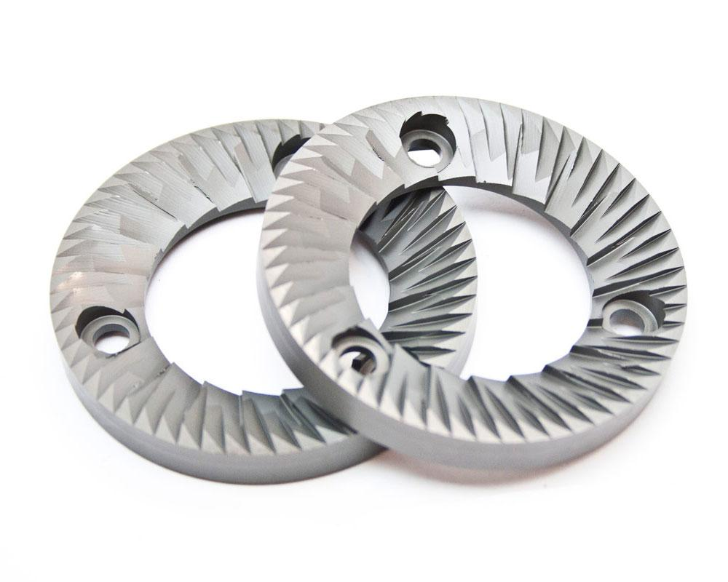
Flat Burrs:

Slide 25
Flat Burrs:
Two Matching Burrs Set Flush Against Each Other

Slide 26
Flat Burrs:
Two Matching Burrs Set Flush Against Each Other
Produce Unimodal Coffee Size Distribution

Slide 27
Unimodal Coffee Distribution:
Creates More Uniform Particle Size Distribution

Slide 28
Unimodal Coffee Distribution:
Creates More Uniform Particle Size Distribution
Extracts More Flavor Without Worrying About Bitter, Dry Flavors from Finer Particles

Slide 29
Unimodal Coffee Distribution:
Because of the Lack of Finer Grinds, Baristas must Grind Finer or Pull Longer Shots

Slide 30
Unimodal Coffee Distribution:
Essential for Espresso Shots with Higher Extraction Yields

Slide 31
Unimodal Coffee Distribution:
Made Popular by Matt Perger’s 2013 World Barista Championship Routine with the Mahlkonig ek43

Slide 32
Unimodal Coffee Distribution:
The Mahlkonig ek43 Features 98mm Steel Burr Set that Creates its Unrivaled Tight Particle Size Distribution

Slide 33
Regardless of Flat or Conical it is Important That the Grinder Has Some Sort of Temperature Control to Help Maintain Consistency When it Comes to Espresso

Slide 34
Coffee Grind Retention is a Problem that Affects Most Espresso Grinders. Stale Coffee with Fresh Coffee or a Variety of Coffee Grind Sizes are the Biggest Problems for Espresso Shot Quality

Slide 35
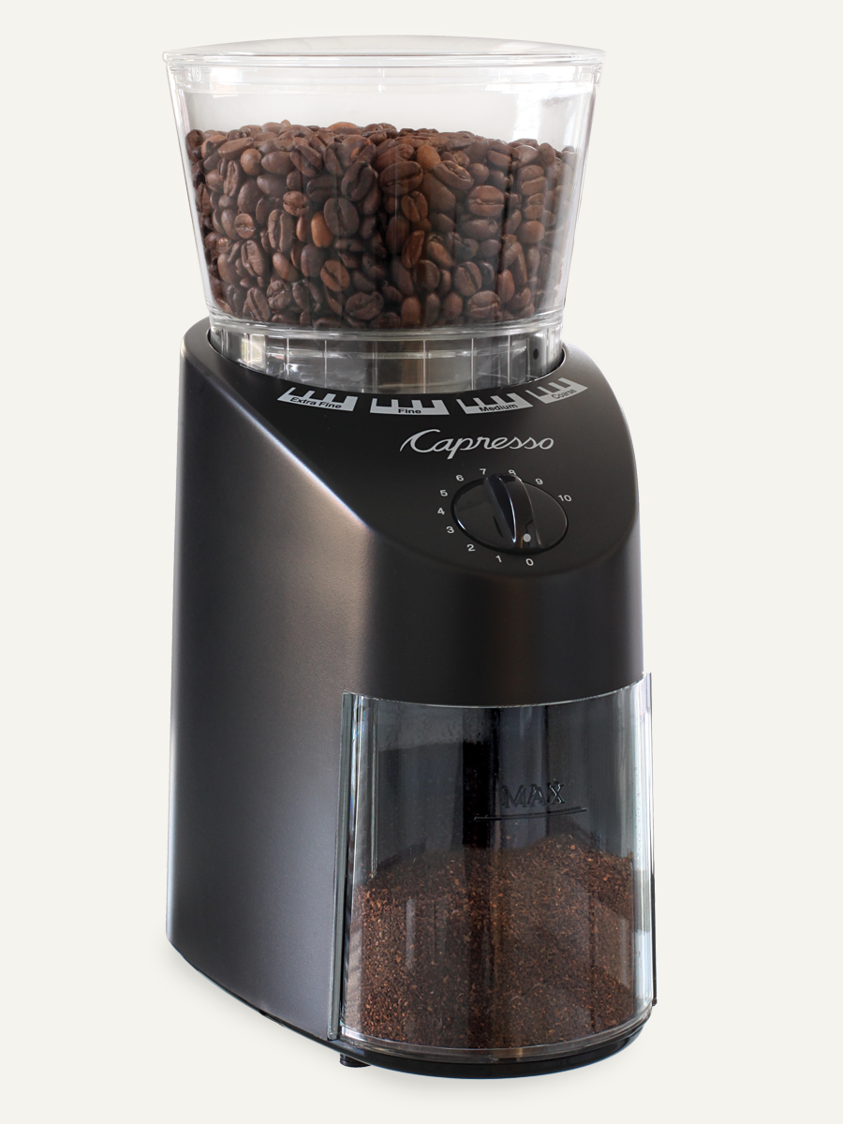
Capresso Infinity Burr Coffee Grinder $99

Slide 36
Capresso Infinity Burr Coffee Grinder $99
Capresso’s conical burrs are produced as matched pairs and are hand assembled in Switzerland for precise fit. Computer-controlled, special grinding heads cut the angles and shapes of the steel burrs to within 0.1 mm precision (1/250 of one inch). The multiple gear motor produces the slowest grinding action (< 450 rpm) for the highest precision grinding from Turkish fine to percolator coarse.

Slide 37
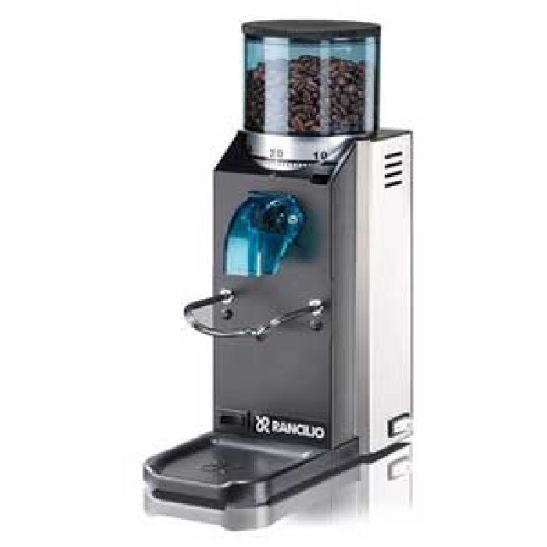
Rancilio Rocky Doserless Espresso Grinder $355

Slide 38
Rancilio Rocky Doserless Espresso Grinder $355
50mm Flat Burr
166w Motor
1725 RPM

Slide 39
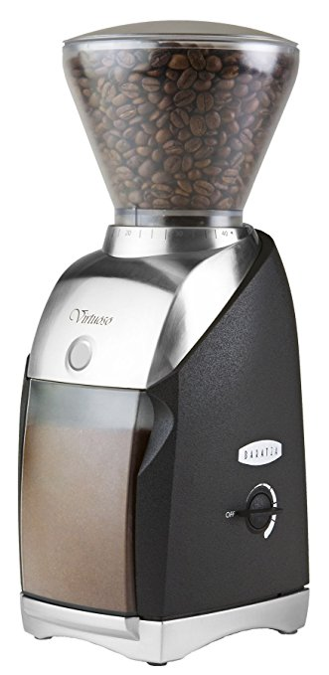
Baratza Virtuoso Conical
Burr $229

Slide 40
Baratza Virtuoso Conical
Burr $229
German Made 40mm Steel Burrs
Grind Range: 250 to 1200 microns
450 RPM Motor

Slide 41
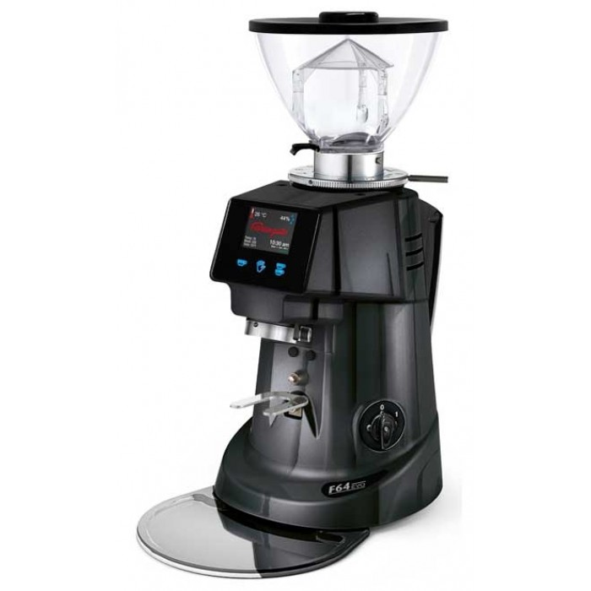
Fiorenzato F64 EVO Espresso Grinder $975

Slide 42
Fiorenzato F64 EVO Espresso Grinder $975
Two progammable dose setting and manual dose option
64 mm flat burrs for fast and quiet operation
3.5 pound bean hopper
Heat activated motor cooling fan
350 watt, 1550 RPM
Dimensions: 9 wide x 9.5 deep x 20" Tall

Slide 43
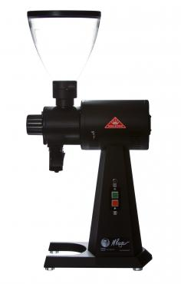
Mahlkonig ek43 $2700

Slide 44
Mahlkonig ek43 $2700
Unmatched Particle Size Distribution
Fewer Fines, Improved Cup Clarity, Higher Extraction Yields without Bitterness
98mm Flat Burrs
1480 RPM

Slide 45
Sifting
Passing Ground Coffee Through a Screen to Achieve Particle Size Consistency to Promote Even Extraction

Slide 46
Sifting
One of the Most Popular Ways to Acheive Sifting is Done with the Kruve Coffee Sifting System
$97

Slide 47
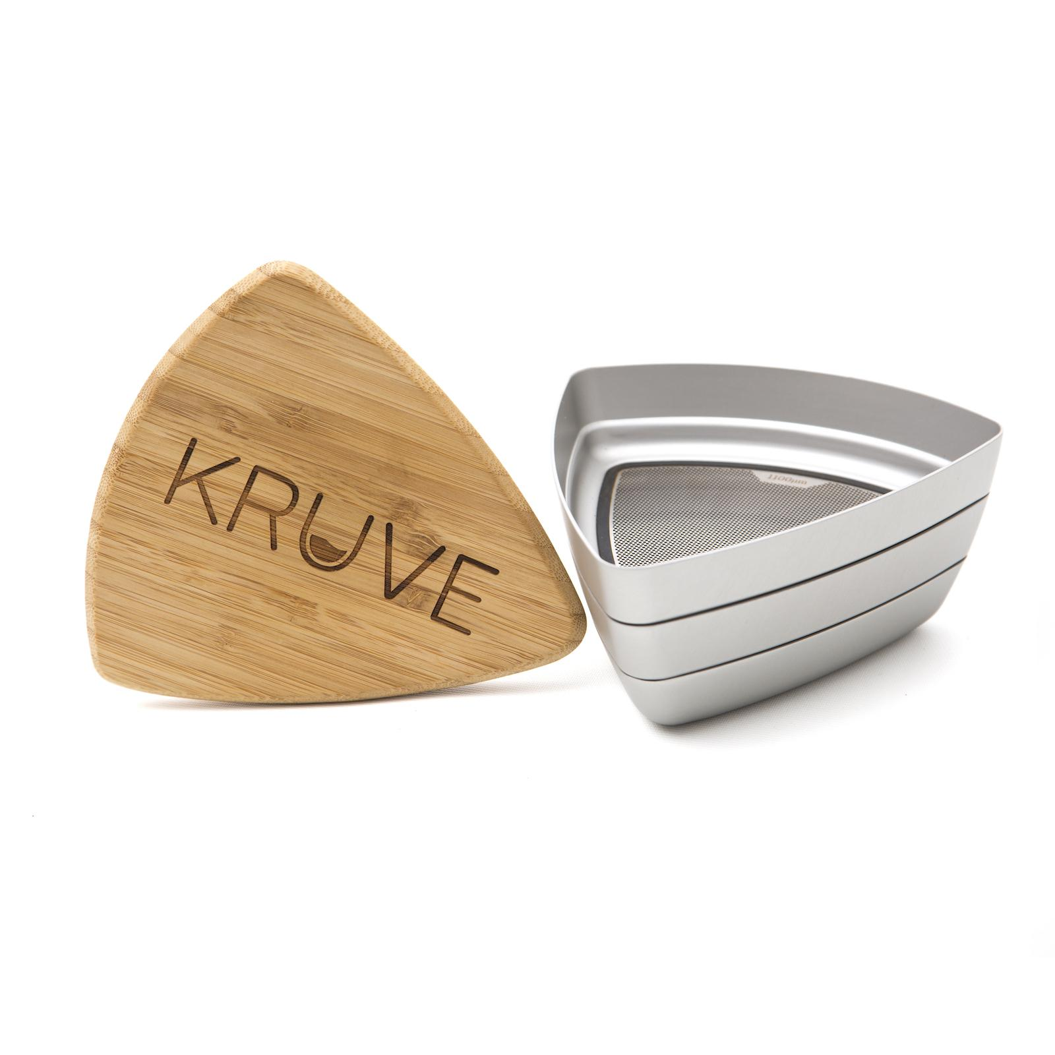
Sifting

Slide 48
Sifting
Each Set Includes 6 or 12 Different Screen Sizes
Simply Select Two Screen Sizes
For Example, Choose a 300 Micron Screen in the Lower Chamber and 1000 Micron Screen in the Upper Chamber to Remove Larger Particles
Shake the Grounds to Sift

Slide 49
Choosing the Right Grind

Slide 50
Choosing the Right Grind
Choose Your Grind Based on Extraction Time
Course Grinds Needs More Extraction Time
Fine Grinds Need Less
Use a Course Grind for Longer Brew Times
(4-8 minutes)
Use a Finer Grind for Shorter Brew Times
(1-4 minutes)

Slide 51
Choosing the Right Grind
Rely on Touch to Determine Grind Particle Size
Kosher Sea Salt for Course
Sand for Medium
Powdered Sugar for Fine

Slide 52
Choosing the Right Grind
Rely on Your Palate to Determine Optimal Grind Setting
Experiment with Grind Setting to Fine Tune the Best Setting for Your Specific Coffee on Your Specific Brewing Method

